Slide 1




HTML Elements and Attributes
Table and DIV
Form
Multimedia and Graphics
MADE MORE
fb.com/angeles.sti.edu
(045) 625-7667
TO
BE

Slide 2
Elements and Attributes
Elements
HTML elements consist of a beginning tag <html> and a closing tag </html>
A tag is surrounded by angle brackets “<>”
HTML elements contain attributes
Attributes
Specified in the start tag
Name = value pair
MADE MORE
fb.com/angeles.sti.edu
(045) 625-7667
TO
BE
Notes:
Syntax – the form of the expressions, statements, and program units of a programming language
When referring to a programming language, the syntax is a set of rules for grammar and spelling. In other words, it means using character structures that a computer can interpret. For example, if a user tries to execute a command without proper syntax, it generates a syntax error, usually causing the program to fail.
Semantics – the meaning of the expressions, statements, and program units of a programming
language
• Lexemes – include the numeric literals, operators, and special words of a programming language
• Token – a category of the lexemes of a language

Slide 3
Elements and Attributes
Common HTML Elements
Heading | Span
Paragraph | Navigation
Links | Forms
Image
List
Division
MADE MORE
fb.com/angeles.sti.edu
(045) 625-7667
TO
BE
Notes:
Syntax – the form of the expressions, statements, and program units of a programming language
When referring to a programming language, the syntax is a set of rules for grammar and spelling. In other words, it means using character structures that a computer can interpret. For example, if a user tries to execute a command without proper syntax, it generates a syntax error, usually causing the program to fail.
Semantics – the meaning of the expressions, statements, and program units of a programming
language
• Lexemes – include the numeric literals, operators, and special words of a programming language
• Token – a category of the lexemes of a language

Slide 4
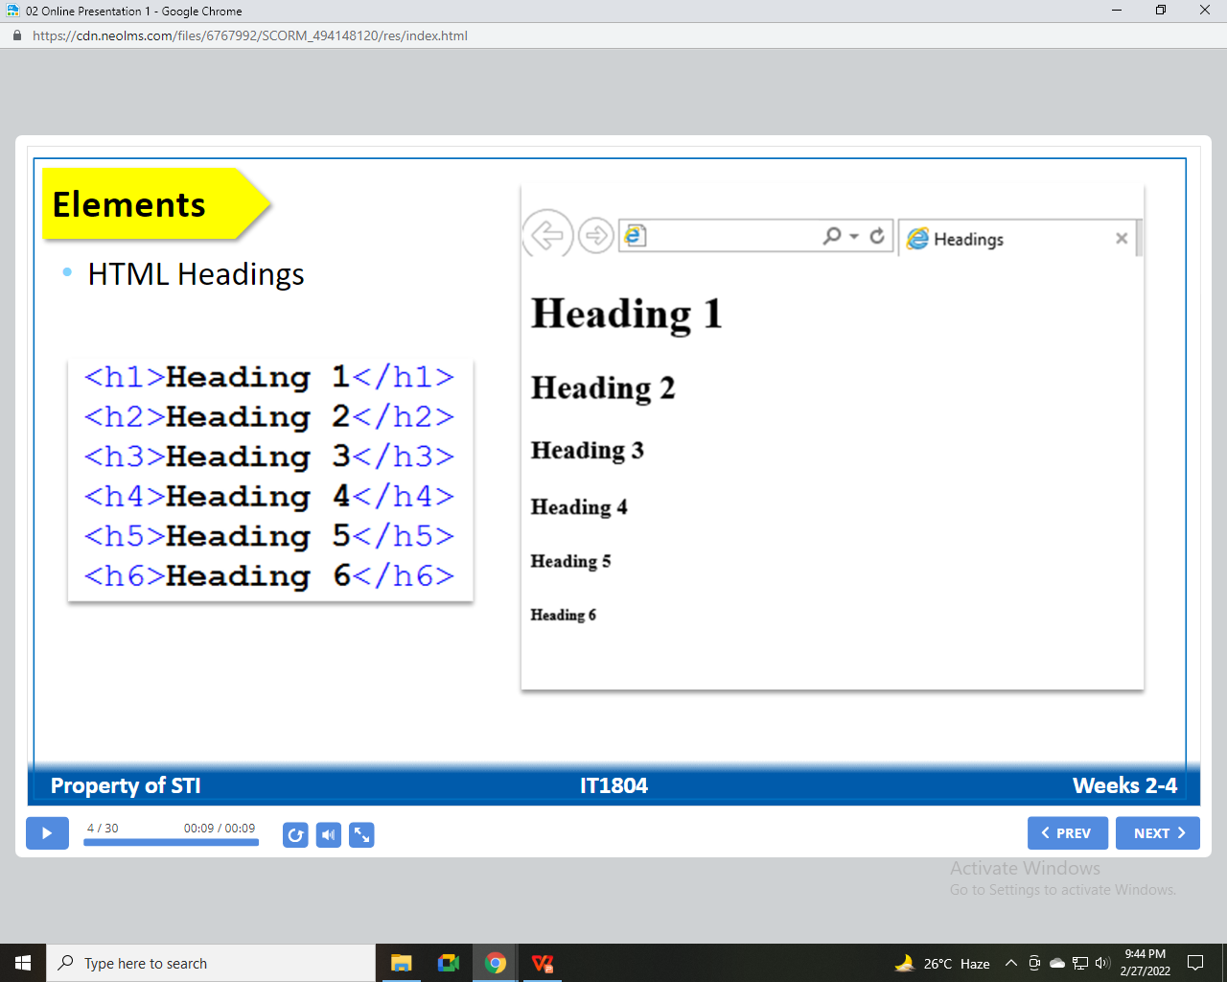
Elements
HTML Headings
MADE MORE
fb.com/angeles.sti.edu
(045) 625-7667
TO
BE
Notes:
Syntax – the form of the expressions, statements, and program units of a programming language
When referring to a programming language, the syntax is a set of rules for grammar and spelling. In other words, it means using character structures that a computer can interpret. For example, if a user tries to execute a command without proper syntax, it generates a syntax error, usually causing the program to fail.
Semantics – the meaning of the expressions, statements, and program units of a programming
language
• Lexemes – include the numeric literals, operators, and special words of a programming language
• Token – a category of the lexemes of a language

Slide 5
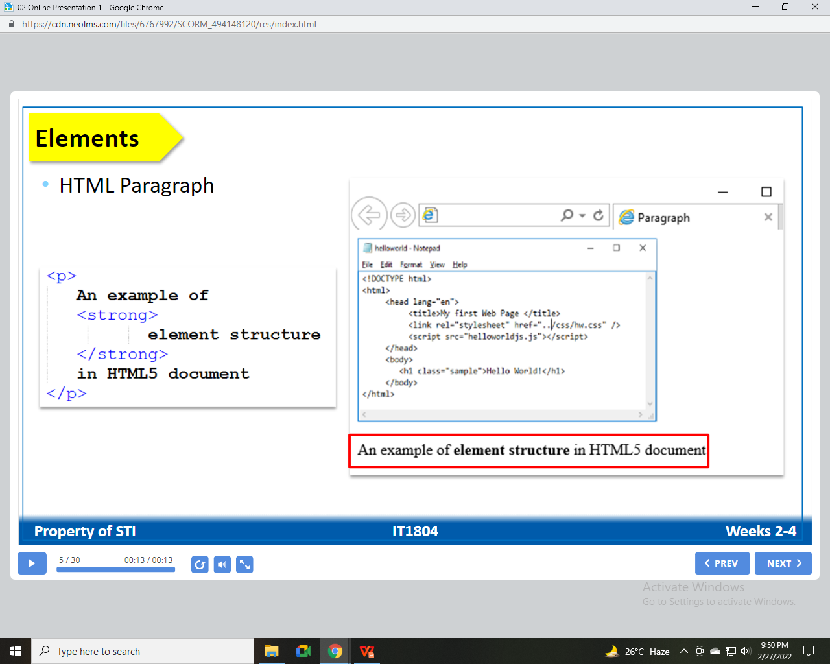
Elements
HTML Paragraph
MADE MORE
fb.com/angeles.sti.edu
(045) 625-7667
TO
BE
Notes:
Syntax – the form of the expressions, statements, and program units of a programming language
When referring to a programming language, the syntax is a set of rules for grammar and spelling. In other words, it means using character structures that a computer can interpret. For example, if a user tries to execute a command without proper syntax, it generates a syntax error, usually causing the program to fail.
Semantics – the meaning of the expressions, statements, and program units of a programming
language
• Lexemes – include the numeric literals, operators, and special words of a programming language
• Token – a category of the lexemes of a language

Slide 6
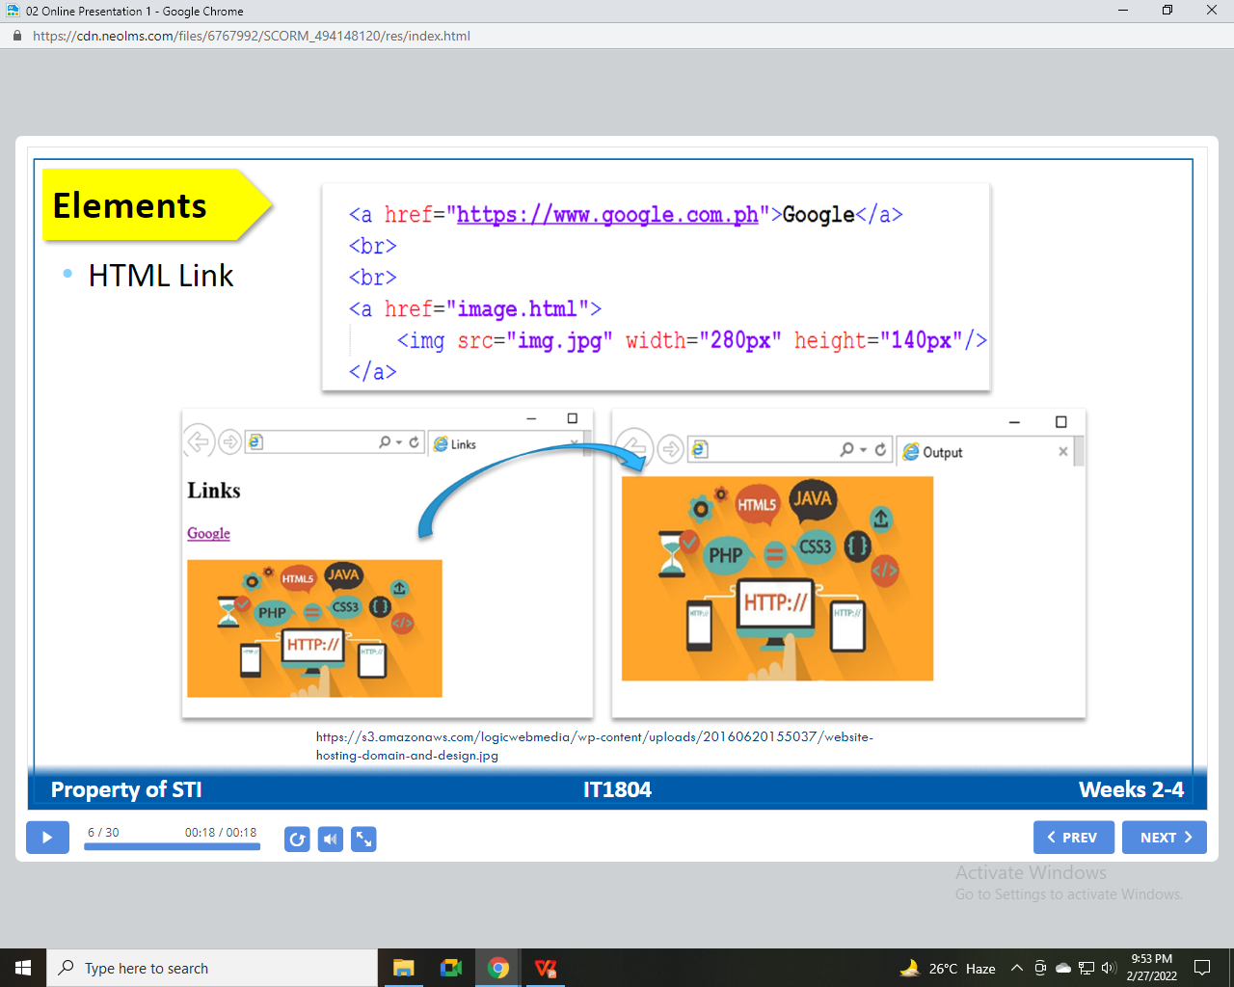
Elements
HTML Link
MADE MORE
fb.com/angeles.sti.edu
(045) 625-7667
TO
BE
Notes:
Syntax – the form of the expressions, statements, and program units of a programming language
When referring to a programming language, the syntax is a set of rules for grammar and spelling. In other words, it means using character structures that a computer can interpret. For example, if a user tries to execute a command without proper syntax, it generates a syntax error, usually causing the program to fail.
Semantics – the meaning of the expressions, statements, and program units of a programming
language
• Lexemes – include the numeric literals, operators, and special words of a programming language
• Token – a category of the lexemes of a language

Slide 7
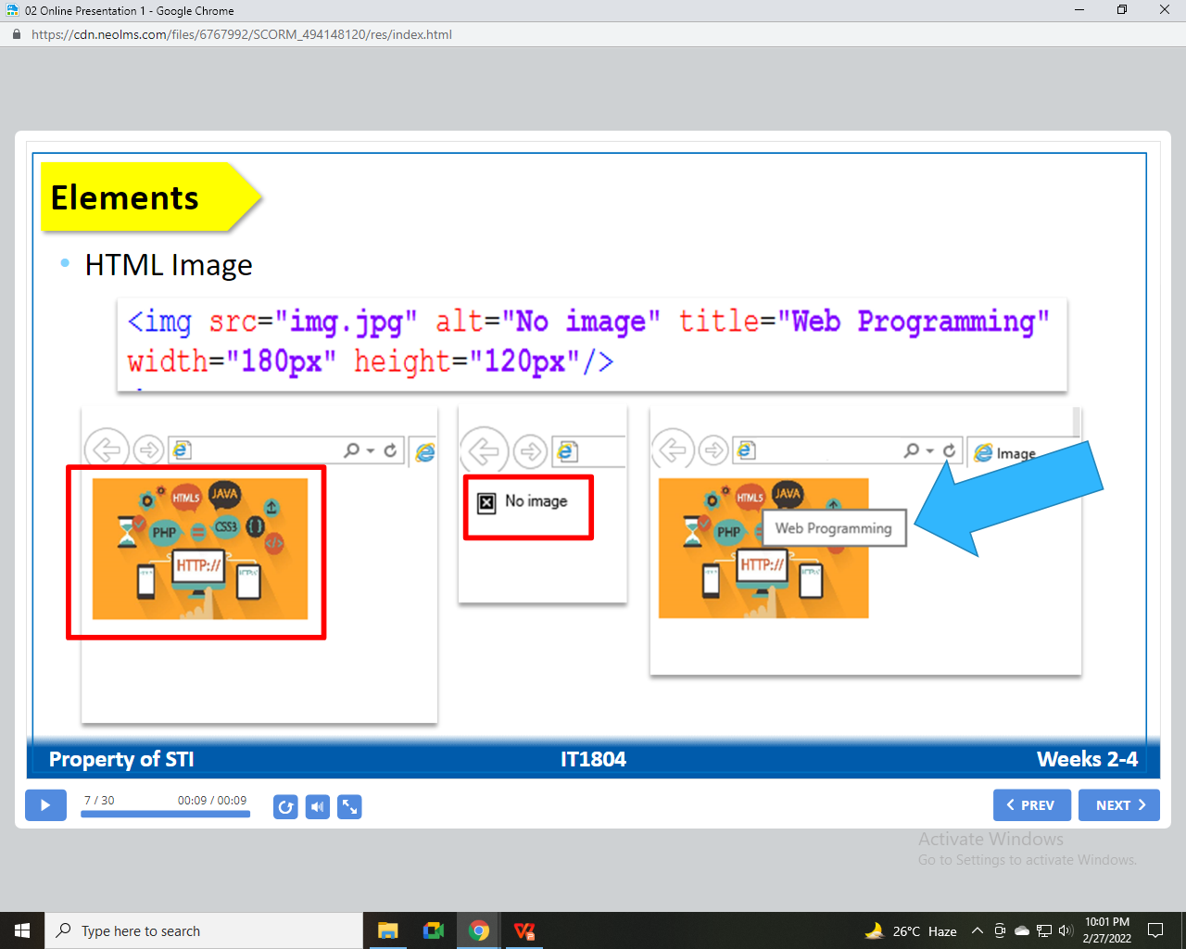
Elements
HTML Image
MADE MORE
fb.com/angeles.sti.edu
(045) 625-7667
TO
BE
Notes:
Syntax – the form of the expressions, statements, and program units of a programming language
When referring to a programming language, the syntax is a set of rules for grammar and spelling. In other words, it means using character structures that a computer can interpret. For example, if a user tries to execute a command without proper syntax, it generates a syntax error, usually causing the program to fail.
Semantics – the meaning of the expressions, statements, and program units of a programming
language
• Lexemes – include the numeric literals, operators, and special words of a programming language
• Token – a category of the lexemes of a language

Slide 8
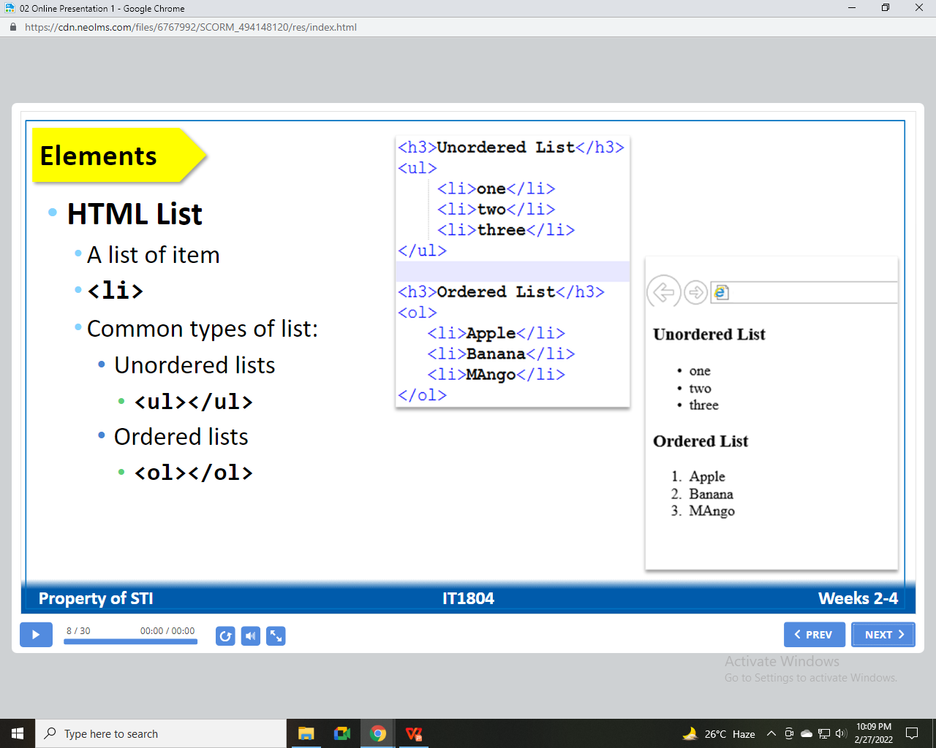
Elements
HTML List
A list of item
<li>
Common types of list:
Unordered lists
<ul></ul>
Ordered lists
<ol></ol>
MADE MORE
fb.com/angeles.sti.edu
(045) 625-7667
TO
BE
Notes:
Syntax – the form of the expressions, statements, and program units of a programming language
When referring to a programming language, the syntax is a set of rules for grammar and spelling. In other words, it means using character structures that a computer can interpret. For example, if a user tries to execute a command without proper syntax, it generates a syntax error, usually causing the program to fail.
Semantics – the meaning of the expressions, statements, and program units of a programming
language
• Lexemes – include the numeric literals, operators, and special words of a programming language
• Token – a category of the lexemes of a language

Slide 9
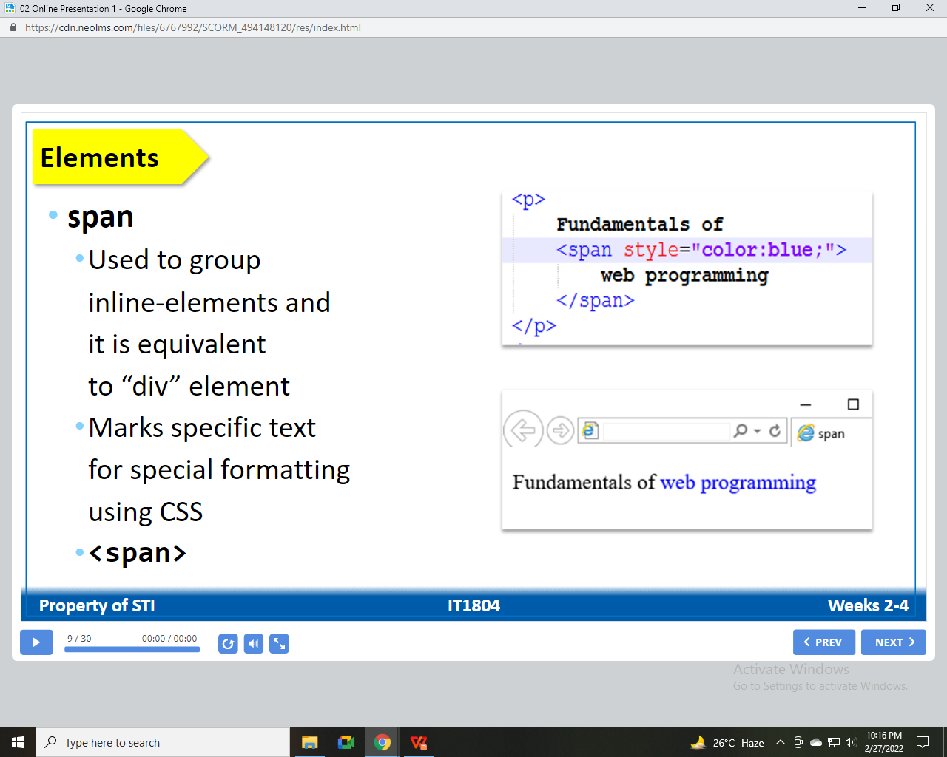
Elements
Span
Used to group inline-elements and it is equivalent to “div” element
Marks specific text for special formatting using CSS
<span>
MADE MORE
fb.com/angeles.sti.edu
(045) 625-7667
TO
BE
Notes:
Syntax – the form of the expressions, statements, and program units of a programming language
When referring to a programming language, the syntax is a set of rules for grammar and spelling. In other words, it means using character structures that a computer can interpret. For example, if a user tries to execute a command without proper syntax, it generates a syntax error, usually causing the program to fail.
Semantics – the meaning of the expressions, statements, and program units of a programming
language
• Lexemes – include the numeric literals, operators, and special words of a programming language
• Token – a category of the lexemes of a language

Slide 10
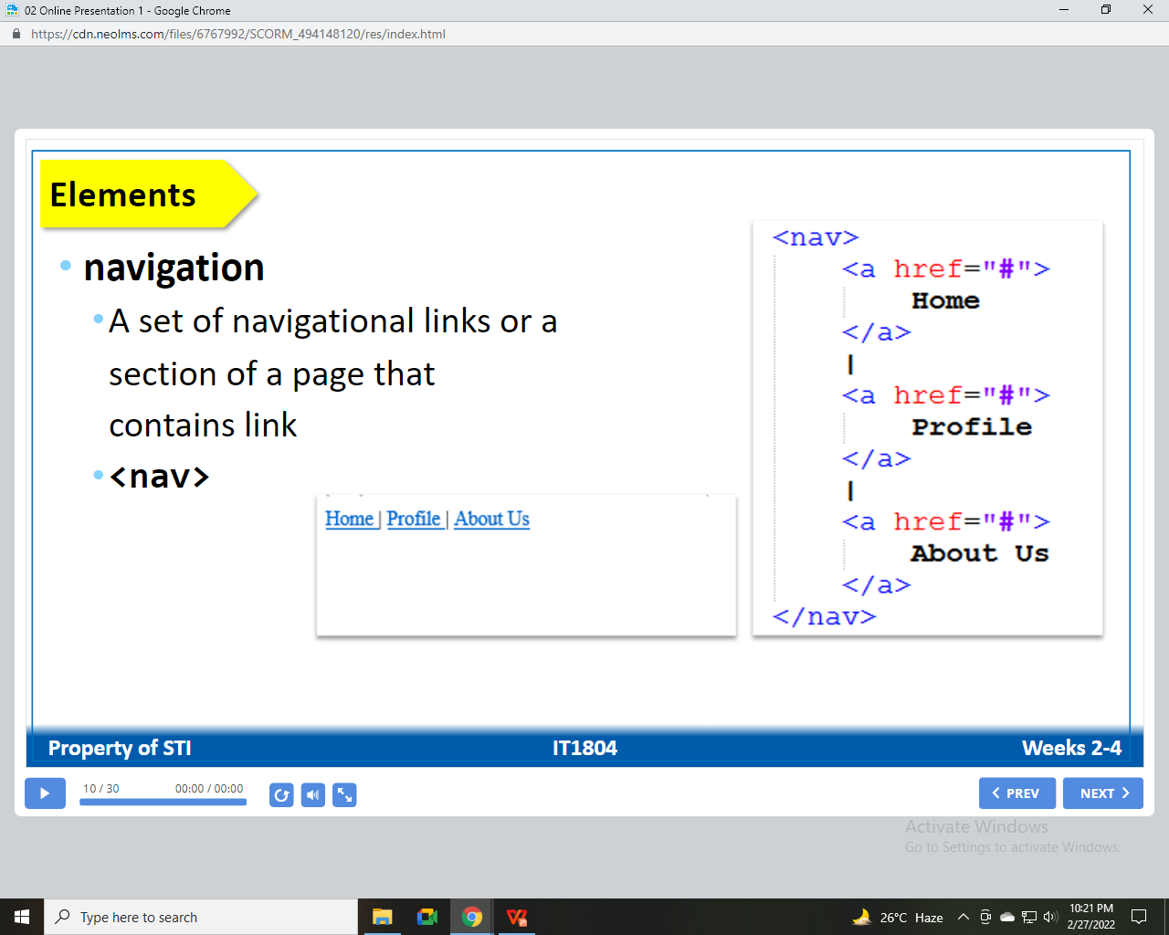
Elements
Navigation
A set of navigation links or a section of a page that contain link
<nav>
MADE MORE
fb.com/angeles.sti.edu
(045) 625-7667
TO
BE
Notes:
Syntax – the form of the expressions, statements, and program units of a programming language
When referring to a programming language, the syntax is a set of rules for grammar and spelling. In other words, it means using character structures that a computer can interpret. For example, if a user tries to execute a command without proper syntax, it generates a syntax error, usually causing the program to fail.
Semantics – the meaning of the expressions, statements, and program units of a programming
language
• Lexemes – include the numeric literals, operators, and special words of a programming language
• Token – a category of the lexemes of a language

Slide 11
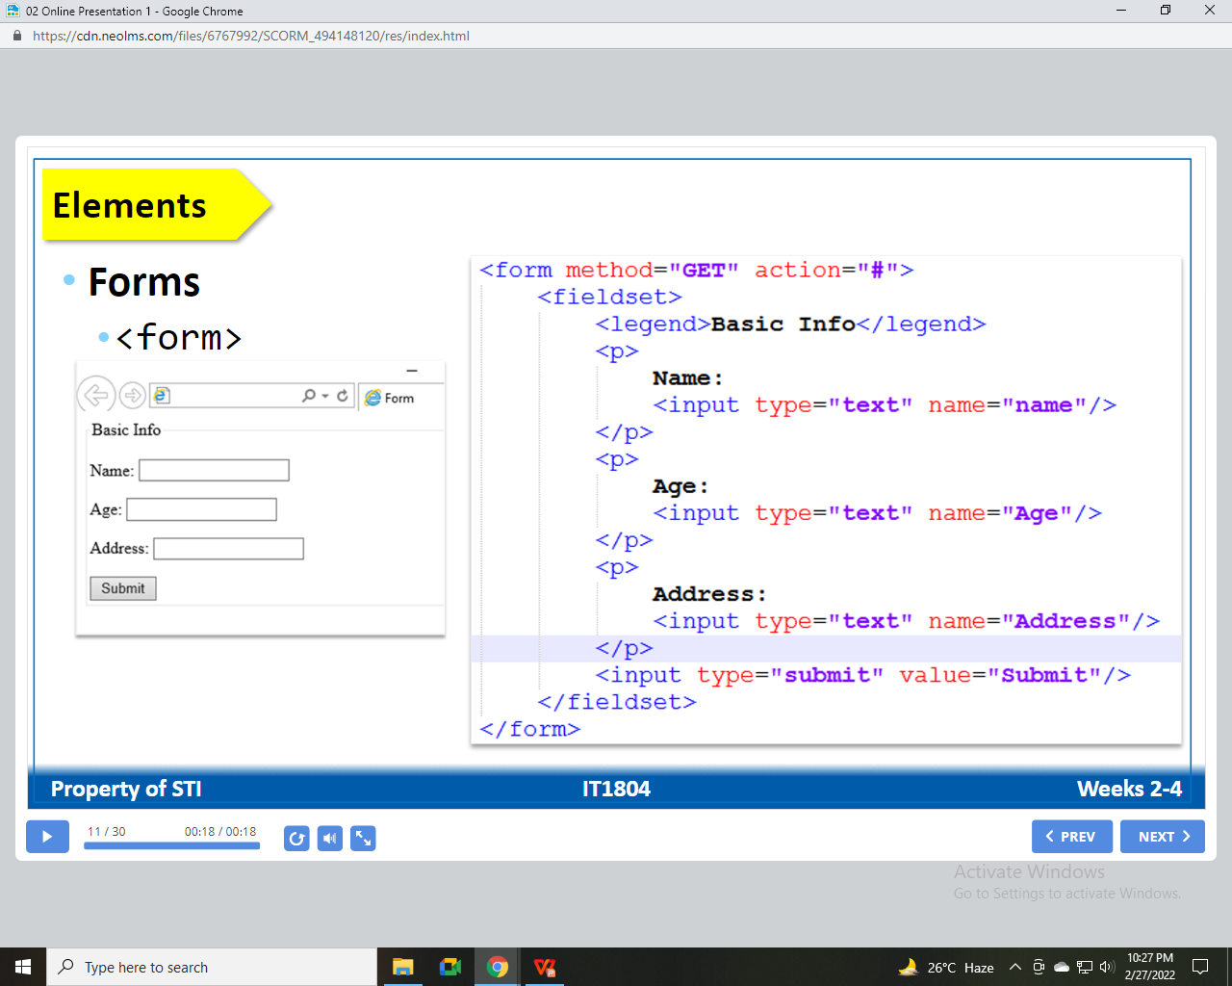
Elements
Forms
<form>
MADE MORE
fb.com/angeles.sti.edu
(045) 625-7667
TO
BE
Notes:
Syntax – the form of the expressions, statements, and program units of a programming language
When referring to a programming language, the syntax is a set of rules for grammar and spelling. In other words, it means using character structures that a computer can interpret. For example, if a user tries to execute a command without proper syntax, it generates a syntax error, usually causing the program to fail.
Semantics – the meaning of the expressions, statements, and program units of a programming
language
• Lexemes – include the numeric literals, operators, and special words of a programming language
• Token – a category of the lexemes of a language

Slide 12
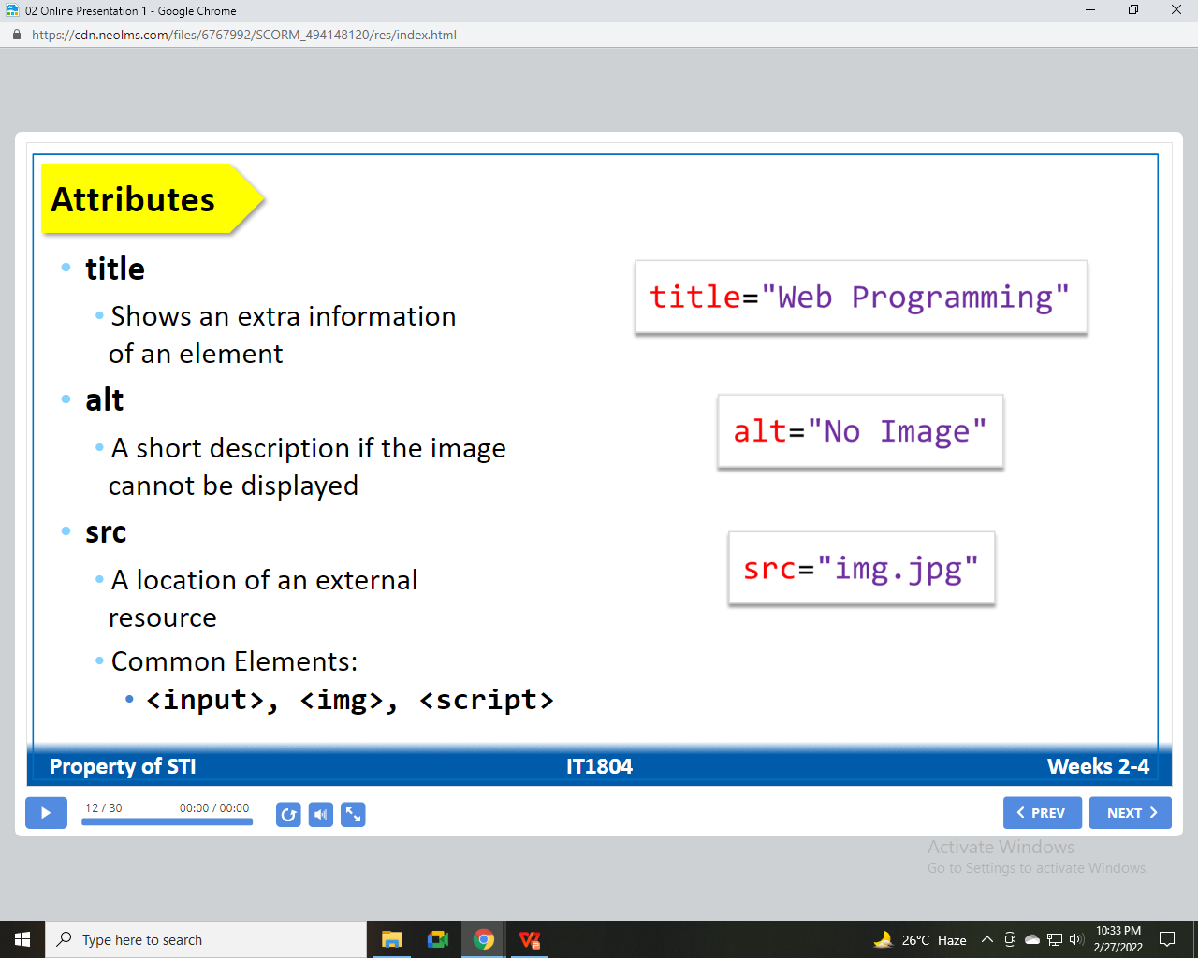
Attributes
title
Shows an extra information of an element
alt
A short description if the image cannot be displayed
src
A location of an external resources
Common Elements:
<input>, <img>, <script>
MADE MORE
fb.com/angeles.sti.edu
(045) 625-7667
TO
BE
Notes:
Syntax – the form of the expressions, statements, and program units of a programming language
When referring to a programming language, the syntax is a set of rules for grammar and spelling. In other words, it means using character structures that a computer can interpret. For example, if a user tries to execute a command without proper syntax, it generates a syntax error, usually causing the program to fail.
Semantics – the meaning of the expressions, statements, and program units of a programming
language
• Lexemes – include the numeric literals, operators, and special words of a programming language
• Token – a category of the lexemes of a language

Slide 13
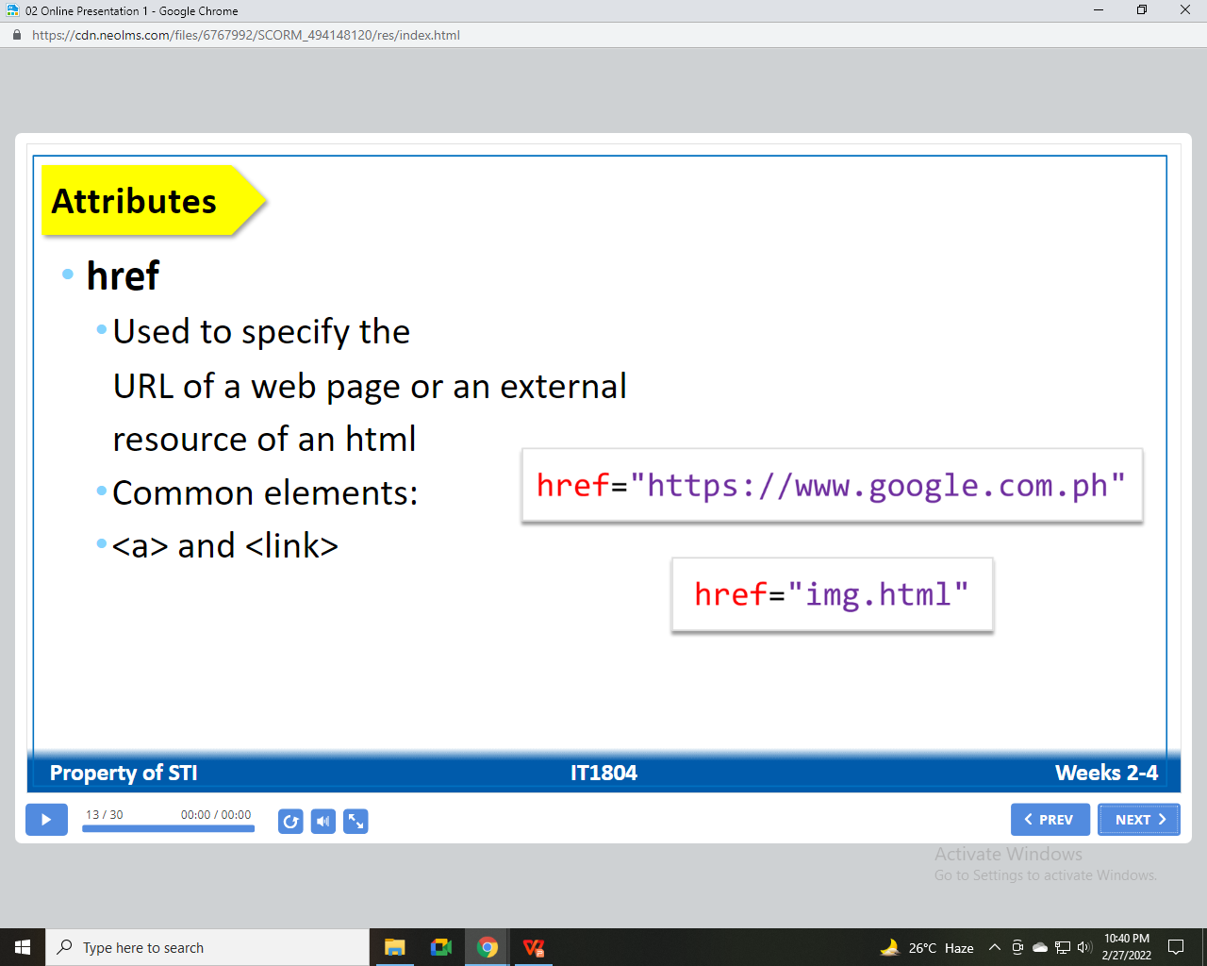
Attributes
href
Used to specify the URL of a web page or an external resource of an html
Common elements:
<a> and <link>
MADE MORE
fb.com/angeles.sti.edu
(045) 625-7667
TO
BE
Notes:
Syntax – the form of the expressions, statements, and program units of a programming language
When referring to a programming language, the syntax is a set of rules for grammar and spelling. In other words, it means using character structures that a computer can interpret. For example, if a user tries to execute a command without proper syntax, it generates a syntax error, usually causing the program to fail.
Semantics – the meaning of the expressions, statements, and program units of a programming
language
• Lexemes – include the numeric literals, operators, and special words of a programming language
• Token – a category of the lexemes of a language

Slide 14
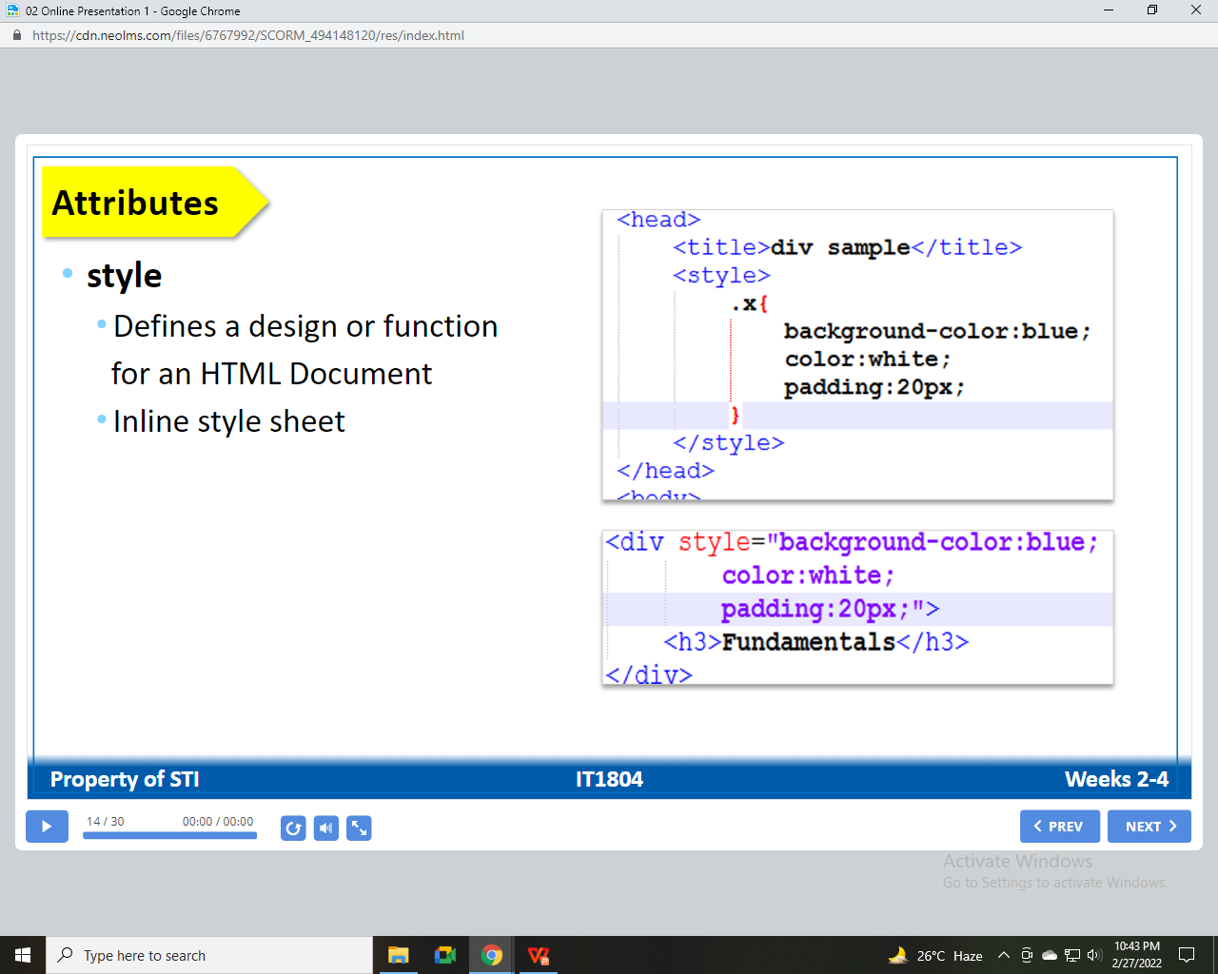
Attributes
style
Defines a design or function for an HTML Document
Inline style sheet
MADE MORE
fb.com/angeles.sti.edu
(045) 625-7667
TO
BE
Notes:
Syntax – the form of the expressions, statements, and program units of a programming language
When referring to a programming language, the syntax is a set of rules for grammar and spelling. In other words, it means using character structures that a computer can interpret. For example, if a user tries to execute a command without proper syntax, it generates a syntax error, usually causing the program to fail.
Semantics – the meaning of the expressions, statements, and program units of a programming
language
• Lexemes – include the numeric literals, operators, and special words of a programming language
• Token – a category of the lexemes of a language

Slide 15
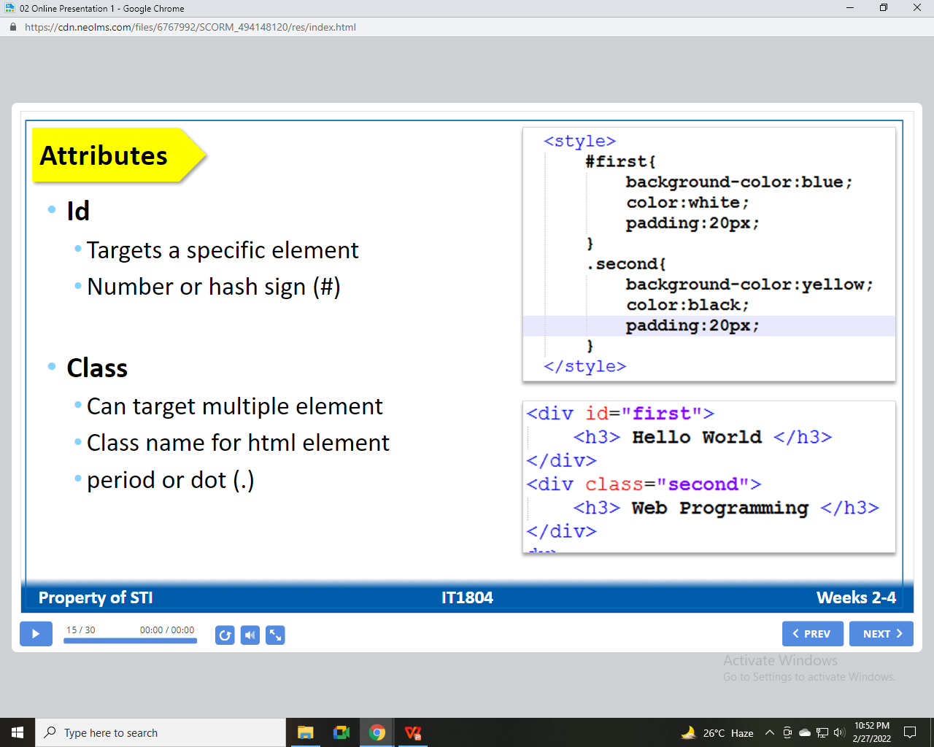
Attributes
Id
Target a specific element
Number or hash sign (#)
Class
Can target multiple element
Class name for html element
period or dot (.)
MADE MORE
fb.com/angeles.sti.edu
(045) 625-7667
TO
BE
Notes:
Syntax – the form of the expressions, statements, and program units of a programming language
When referring to a programming language, the syntax is a set of rules for grammar and spelling. In other words, it means using character structures that a computer can interpret. For example, if a user tries to execute a command without proper syntax, it generates a syntax error, usually causing the program to fail.
Semantics – the meaning of the expressions, statements, and program units of a programming
language
• Lexemes – include the numeric literals, operators, and special words of a programming language
• Token – a category of the lexemes of a language

Slide 16
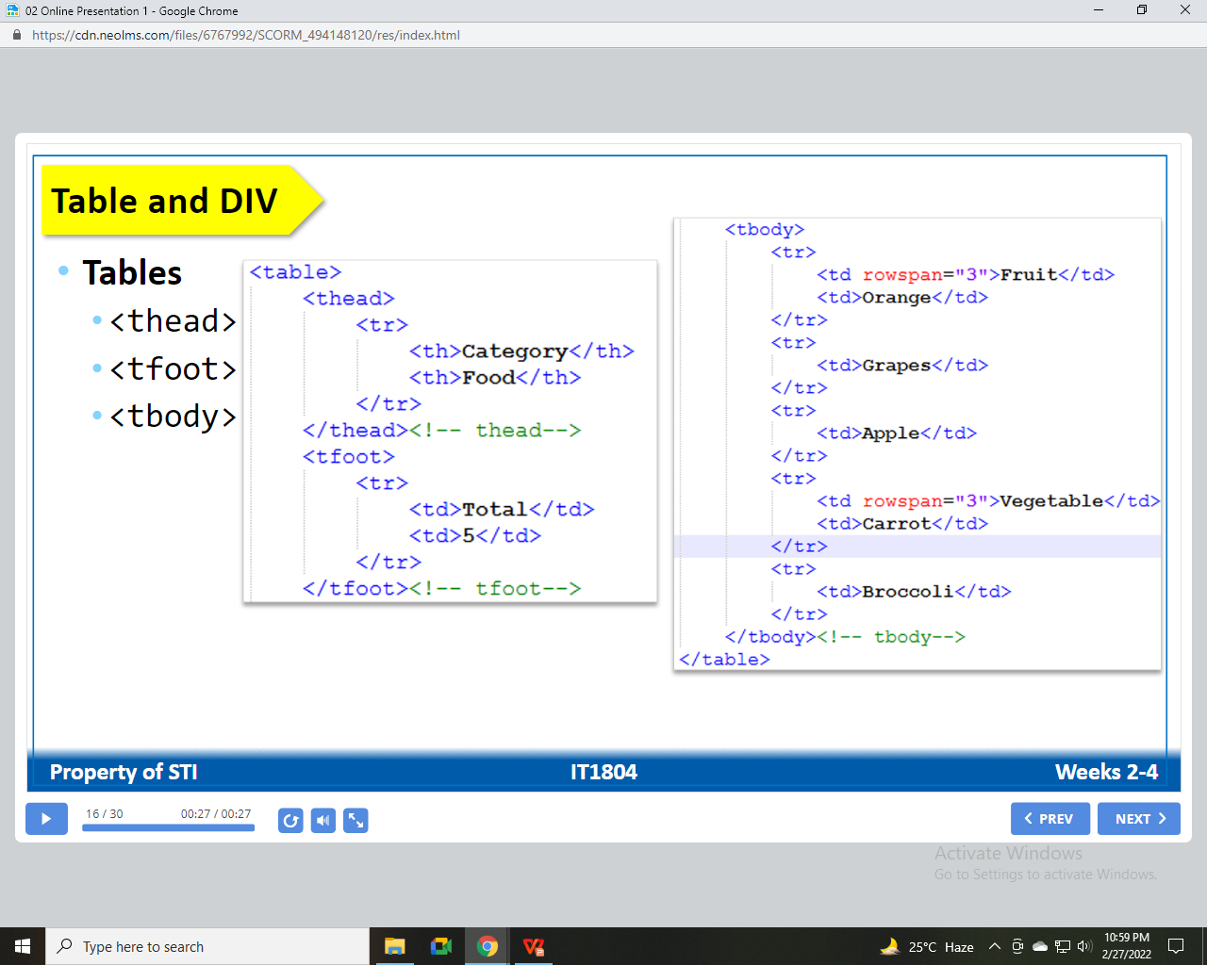
Table and DIV
Table
<thread>
<tfoot>
<tbody>
MADE MORE
fb.com/angeles.sti.edu
(045) 625-7667
TO
BE
Notes:
Syntax – the form of the expressions, statements, and program units of a programming language
When referring to a programming language, the syntax is a set of rules for grammar and spelling. In other words, it means using character structures that a computer can interpret. For example, if a user tries to execute a command without proper syntax, it generates a syntax error, usually causing the program to fail.
Semantics – the meaning of the expressions, statements, and program units of a programming
language
• Lexemes – include the numeric literals, operators, and special words of a programming language
• Token – a category of the lexemes of a language

Slide 17
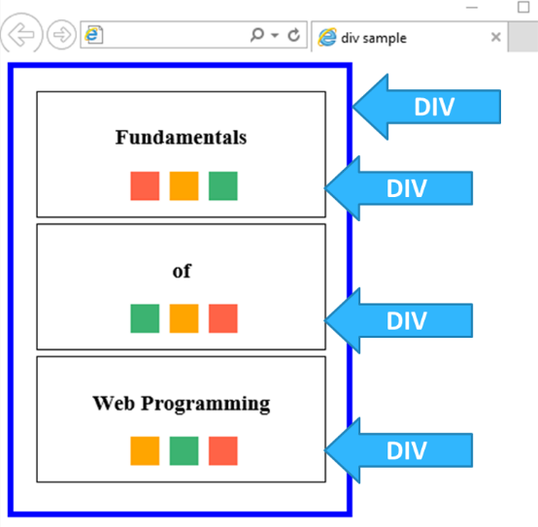
Table and DIV
Division
<div> </div>
MADE MORE
fb.com/angeles.sti.edu
(045) 625-7667
TO
BE
Notes:
Syntax – the form of the expressions, statements, and program units of a programming language
When referring to a programming language, the syntax is a set of rules for grammar and spelling. In other words, it means using character structures that a computer can interpret. For example, if a user tries to execute a command without proper syntax, it generates a syntax error, usually causing the program to fail.
Semantics – the meaning of the expressions, statements, and program units of a programming
language
• Lexemes – include the numeric literals, operators, and special words of a programming language
• Token – a category of the lexemes of a language

Slide 18
Forms
FORM CONTROL ELEMENTS
Text Input Control
Choice Control
Button Control
Date and Time Control
MADE MORE
fb.com/angeles.sti.edu
(045) 625-7667
TO
BE
Notes:
Syntax – the form of the expressions, statements, and program units of a programming language
When referring to a programming language, the syntax is a set of rules for grammar and spelling. In other words, it means using character structures that a computer can interpret. For example, if a user tries to execute a command without proper syntax, it generates a syntax error, usually causing the program to fail.
Semantics – the meaning of the expressions, statements, and program units of a programming
language
• Lexemes – include the numeric literals, operators, and special words of a programming language
• Token – a category of the lexemes of a language

Slide 19
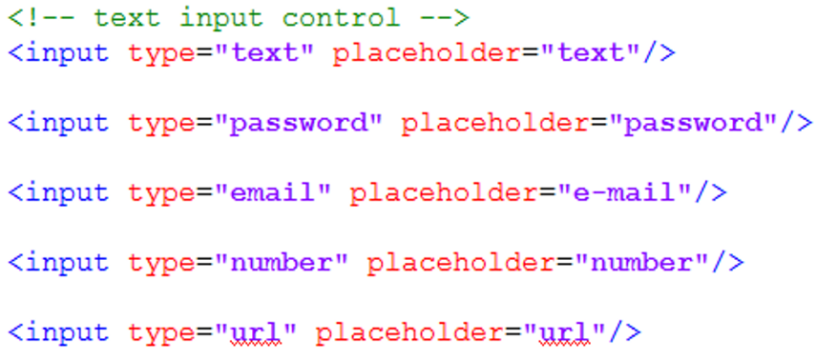
Forms
Text Input Control
MADE MORE
fb.com/angeles.sti.edu
(045) 625-7667
TO
BE
Notes:
Syntax – the form of the expressions, statements, and program units of a programming language
When referring to a programming language, the syntax is a set of rules for grammar and spelling. In other words, it means using character structures that a computer can interpret. For example, if a user tries to execute a command without proper syntax, it generates a syntax error, usually causing the program to fail.
Semantics – the meaning of the expressions, statements, and program units of a programming
language
• Lexemes – include the numeric literals, operators, and special words of a programming language
• Token – a category of the lexemes of a language

Slide 20
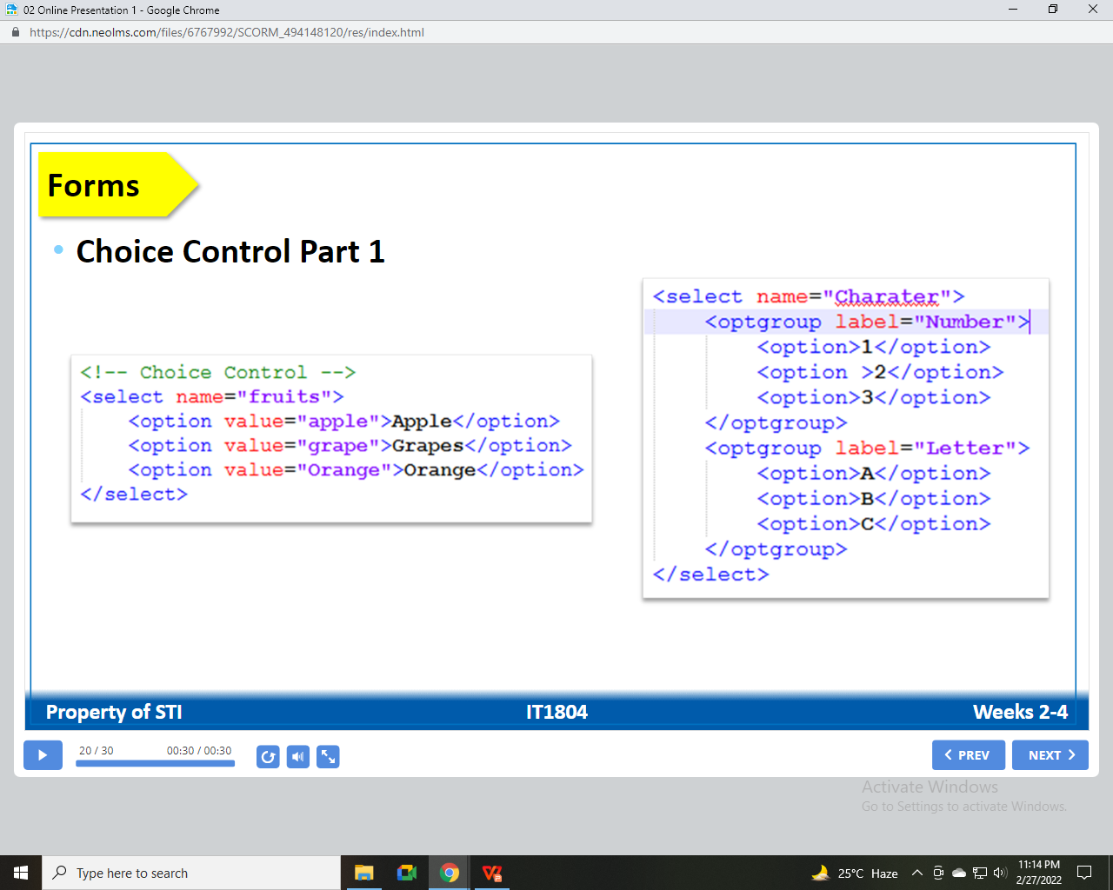
Forms
Choice Control Part 1
MADE MORE
fb.com/angeles.sti.edu
(045) 625-7667
TO
BE
Notes:
Syntax – the form of the expressions, statements, and program units of a programming language
When referring to a programming language, the syntax is a set of rules for grammar and spelling. In other words, it means using character structures that a computer can interpret. For example, if a user tries to execute a command without proper syntax, it generates a syntax error, usually causing the program to fail.
Semantics – the meaning of the expressions, statements, and program units of a programming
language
• Lexemes – include the numeric literals, operators, and special words of a programming language
• Token – a category of the lexemes of a language

Slide 21
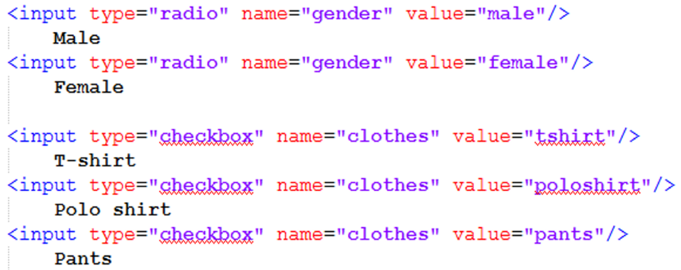
Forms
Choice Control Part 2
MADE MORE
fb.com/angeles.sti.edu
(045) 625-7667
TO
BE
Notes:
Syntax – the form of the expressions, statements, and program units of a programming language
When referring to a programming language, the syntax is a set of rules for grammar and spelling. In other words, it means using character structures that a computer can interpret. For example, if a user tries to execute a command without proper syntax, it generates a syntax error, usually causing the program to fail.
Semantics – the meaning of the expressions, statements, and program units of a programming
language
• Lexemes – include the numeric literals, operators, and special words of a programming language
• Token – a category of the lexemes of a language

Slide 22
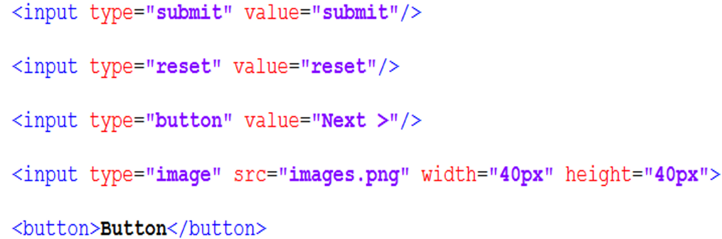
Forms
Button Control
MADE MORE
fb.com/angeles.sti.edu
(045) 625-7667
TO
BE
Notes:
Syntax – the form of the expressions, statements, and program units of a programming language
When referring to a programming language, the syntax is a set of rules for grammar and spelling. In other words, it means using character structures that a computer can interpret. For example, if a user tries to execute a command without proper syntax, it generates a syntax error, usually causing the program to fail.
Semantics – the meaning of the expressions, statements, and program units of a programming
language
• Lexemes – include the numeric literals, operators, and special words of a programming language
• Token – a category of the lexemes of a language

Slide 23
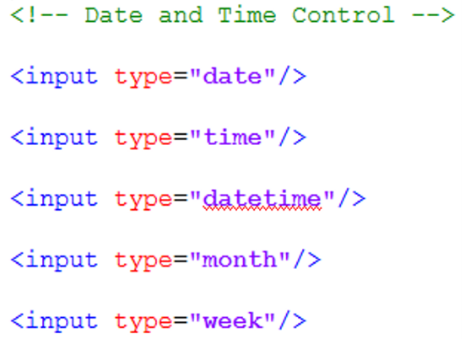
Forms
Date and Time Control
MADE MORE
fb.com/angeles.sti.edu
(045) 625-7667
TO
BE
Notes:
Syntax – the form of the expressions, statements, and program units of a programming language
When referring to a programming language, the syntax is a set of rules for grammar and spelling. In other words, it means using character structures that a computer can interpret. For example, if a user tries to execute a command without proper syntax, it generates a syntax error, usually causing the program to fail.
Semantics – the meaning of the expressions, statements, and program units of a programming
language
• Lexemes – include the numeric literals, operators, and special words of a programming language
• Token – a category of the lexemes of a language

Slide 24
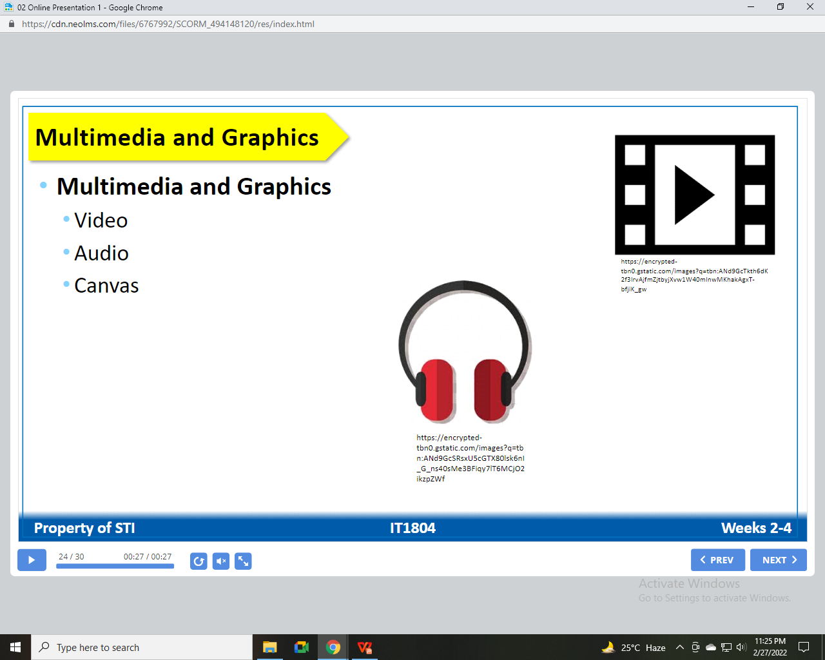
Multimedia and Graphics
Multimedia and Graphics
Video
Audio
Canvas
MADE MORE
fb.com/angeles.sti.edu
(045) 625-7667
TO
BE
Notes:
Syntax – the form of the expressions, statements, and program units of a programming language
When referring to a programming language, the syntax is a set of rules for grammar and spelling. In other words, it means using character structures that a computer can interpret. For example, if a user tries to execute a command without proper syntax, it generates a syntax error, usually causing the program to fail.
Semantics – the meaning of the expressions, statements, and program units of a programming
language
• Lexemes – include the numeric literals, operators, and special words of a programming language
• Token – a category of the lexemes of a language

Slide 25
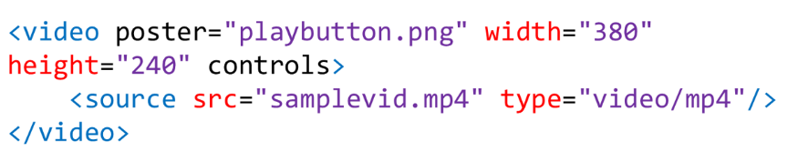
Multimedia and Graphics
Video
File formats
mp4
ogg
webm
MADE MORE
fb.com/angeles.sti.edu
(045) 625-7667
TO
BE
Notes:
Syntax – the form of the expressions, statements, and program units of a programming language
When referring to a programming language, the syntax is a set of rules for grammar and spelling. In other words, it means using character structures that a computer can interpret. For example, if a user tries to execute a command without proper syntax, it generates a syntax error, usually causing the program to fail.
Semantics – the meaning of the expressions, statements, and program units of a programming
language
• Lexemes – include the numeric literals, operators, and special words of a programming language
• Token – a category of the lexemes of a language

Slide 26
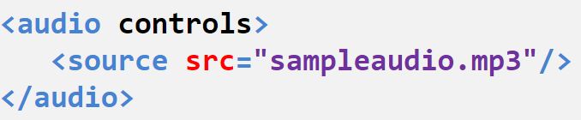
Multimedia and Graphics
Audio
File formats
mp3
wav
MADE MORE
fb.com/angeles.sti.edu
(045) 625-7667
TO
BE
Notes:
Syntax – the form of the expressions, statements, and program units of a programming language
When referring to a programming language, the syntax is a set of rules for grammar and spelling. In other words, it means using character structures that a computer can interpret. For example, if a user tries to execute a command without proper syntax, it generates a syntax error, usually causing the program to fail.
Semantics – the meaning of the expressions, statements, and program units of a programming
language
• Lexemes – include the numeric literals, operators, and special words of a programming language
• Token – a category of the lexemes of a language

Slide 27
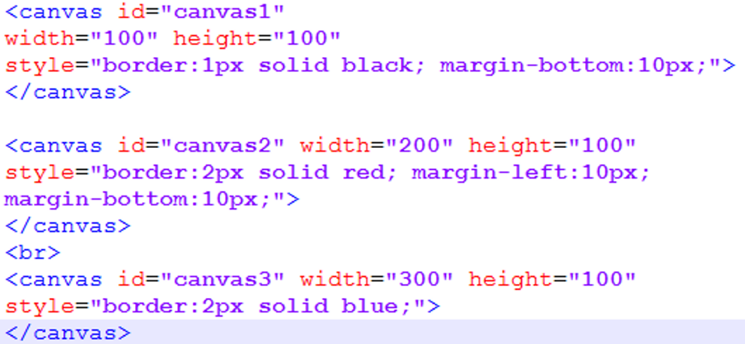
Multimedia and Graphics
Canvas
HTML
MADE MORE
fb.com/angeles.sti.edu
(045) 625-7667
TO
BE
Notes:
Syntax – the form of the expressions, statements, and program units of a programming language
When referring to a programming language, the syntax is a set of rules for grammar and spelling. In other words, it means using character structures that a computer can interpret. For example, if a user tries to execute a command without proper syntax, it generates a syntax error, usually causing the program to fail.
Semantics – the meaning of the expressions, statements, and program units of a programming
language
• Lexemes – include the numeric literals, operators, and special words of a programming language
• Token – a category of the lexemes of a language

Slide 28
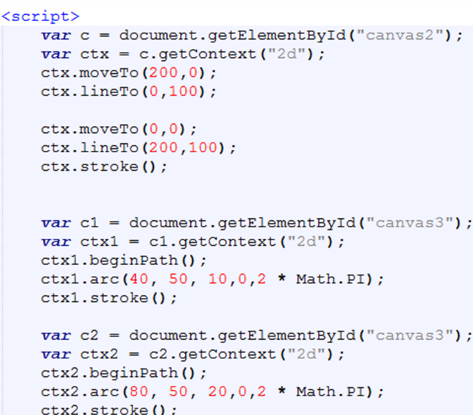
Multimedia and Graphics
Canvas
Script Part l
MADE MORE
fb.com/angeles.sti.edu
(045) 625-7667
TO
BE
Notes:
Syntax – the form of the expressions, statements, and program units of a programming language
When referring to a programming language, the syntax is a set of rules for grammar and spelling. In other words, it means using character structures that a computer can interpret. For example, if a user tries to execute a command without proper syntax, it generates a syntax error, usually causing the program to fail.
Semantics – the meaning of the expressions, statements, and program units of a programming
language
• Lexemes – include the numeric literals, operators, and special words of a programming language
• Token – a category of the lexemes of a language

Slide 29
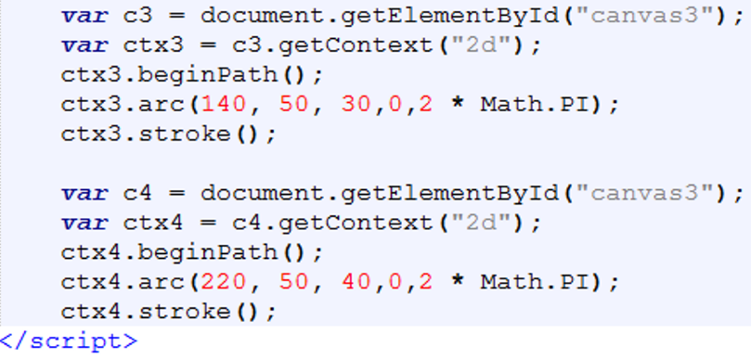
Multimedia and Graphics
Canvas
Script Part ll
MADE MORE
fb.com/angeles.sti.edu
(045) 625-7667
TO
BE
Notes:
Syntax – the form of the expressions, statements, and program units of a programming language
When referring to a programming language, the syntax is a set of rules for grammar and spelling. In other words, it means using character structures that a computer can interpret. For example, if a user tries to execute a command without proper syntax, it generates a syntax error, usually causing the program to fail.
Semantics – the meaning of the expressions, statements, and program units of a programming
language
• Lexemes – include the numeric literals, operators, and special words of a programming language
• Token – a category of the lexemes of a language

Slide 30
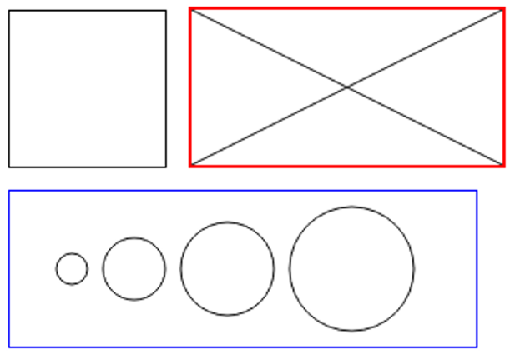
Multimedia and Graphics
Canvas
Output
MADE MORE
fb.com/angeles.sti.edu
(045) 625-7667
TO
BE
Notes:
Syntax – the form of the expressions, statements, and program units of a programming language
When referring to a programming language, the syntax is a set of rules for grammar and spelling. In other words, it means using character structures that a computer can interpret. For example, if a user tries to execute a command without proper syntax, it generates a syntax error, usually causing the program to fail.
Semantics – the meaning of the expressions, statements, and program units of a programming
language
• Lexemes – include the numeric literals, operators, and special words of a programming language
• Token – a category of the lexemes of a language

